Slide 1

Golf Player Time Management System (GPTMS)
Quentin Sheets, Dustin Bramos, Jakob Welchner, Luis Ramirez, Collin Junkersfeld, Travis Thayer
CSI 4999: Senior Capstone
Github: https://github.com/quentinxs/GPTMS

Slide 2
Problem Statement
Maintaining the “pace of play” for many golf courses can be quite challenging, and is usually performed manually by a starter or ranger. Many times, this approach can be inconsistent; which can lead to increased wait times for players and traffic jams inside the course. Additionally, any players who would like to play through would have to make a verbal request to the players ahead of them, which can be inconvenient and troublesome at times. These inconsistencies and inconveniences can be resolved by automating the responsibilities of the starter/ranger. Tracking player location provides golf course management the ability to optimize the pace of play by calculating player speeds and wait times. This information is then used to automatically notify players of their pace of play or to request a play through, either automatically or manually from another player.
Notes:
Travis

Slide 3
Objectives
Optimizing pace of play by tracking player location and using this data to calculate player speeds and wait times.
Alerting players of wait times, pace of play, requests to play through, and/or services and assistance from staff members.
Interconnects golf staff and players, allowing for a more fluid, interactive experience.
Notes:
Travis

Slide 4
Functional Requirements
Provide helpful hints about the course based on the location of the player.
System shall allow players to register and login on the application and register at each golf course/range.
App displays progress on the course, playing time, Warnings about playing speed, and request to allow playthrough.
Player history and dashboard is viewable
Track players position on a virtual golf course utilizing an application on the players phones that transmits GPS location information; possibly using geo-fencing for more accurate location data and automation.
Notes:
Jakob

Slide 5
Non-Functional Requirements
Downloadable application from standard stores
The system shall track in real time
System shall monitor player behavior and provide a player dashboard.
Software should be portable
Encrypt communication between client and central server
Notes:
Jakob

Slide 6
Target Environment
Toolchain
Golf staff and players will both access the GPTMS via a web browser, or by downloading the app via Google Play or the Apple App Store.
Native Mobile App (Android): Android Studio
Native Mobile App (iOS): Swift > XCode
Web App: Visual Studio, IntelliJ, NetBeans > GCP or AWS
Notes:
Quentin
Target Environment (not final)
Toolchain: (not final)

Slide 7
Languages
Configuration Management
Frontend: HTML5, JS/TypeScript
Backend: Python + Flask, JS
Framework: JSON, jQuery, Bootstrap, Angular or React
iOS: Swift / Android: Java
Database: SQL/mySQL
Bitnami and GCP
Notes:
Quentin
Languages: (not final)
Configuration Management: (not final)

Slide 8
Server Setup
Central server that the application connects to remotely.
Hosted by Google Cloud Platform.
Using the platform, the server will be created on a virtual machine instance.
The virtual machine server will host the user database along with the data processing on the back end.
LAMP stack (Linux, Apache, mySQL, Python)
Create a web application that is easily accessible from both mobile and desktop through a web browser.
Notes:
Dustin

Slide 9
Development Environment
IDE, Github, debugging tools, etc.
Web-App
Visual Studio - free, only available for windows open source comes with a debugging tool
Supports - Python, HTML, CSS, Javascript, PHP, Sass. Node.js, Typescript
Atom-> free, allows for real time collaboration on code, easy to use with Github
Supports - HTML, Java, JavaScript, JSON, Python, PHP, SQL, CSS, Node.js
Eclipse-> free cross platform, mostly centered around Java
Supports - Python, Javascript, PHP, Java, Node.js
Komodo ->Comes with Debugging/Unit Testing, free, available cross platform.
Supports - HTML, CSS, Python, Node.js, Javascript, PHP, Sass
Mobile
Android Studio - Free, available for Android development
Supports - Java and Kotlin
Xcode - Free, available for iOS development
Supports - Java, Python, Swift, Objective-C and frameworks such as Cocoa
Notes:
Dustin
Development Environment: (need approval)

Slide 10
Project Model
User Stories
SCRUM
As a player I want to request to play through the player ahead of me so that I can optimize my pace of play.
As a player I want to be able to see how long 18 holes of golf will take me depending on my prior times so that I can schedule myself well.
As a course staff member I want to be able to check player paces so that I can give players proper wait times.
As a player I want to be able to receive tips while playing so I can improve my game.
Notes:
collin

Slide 11
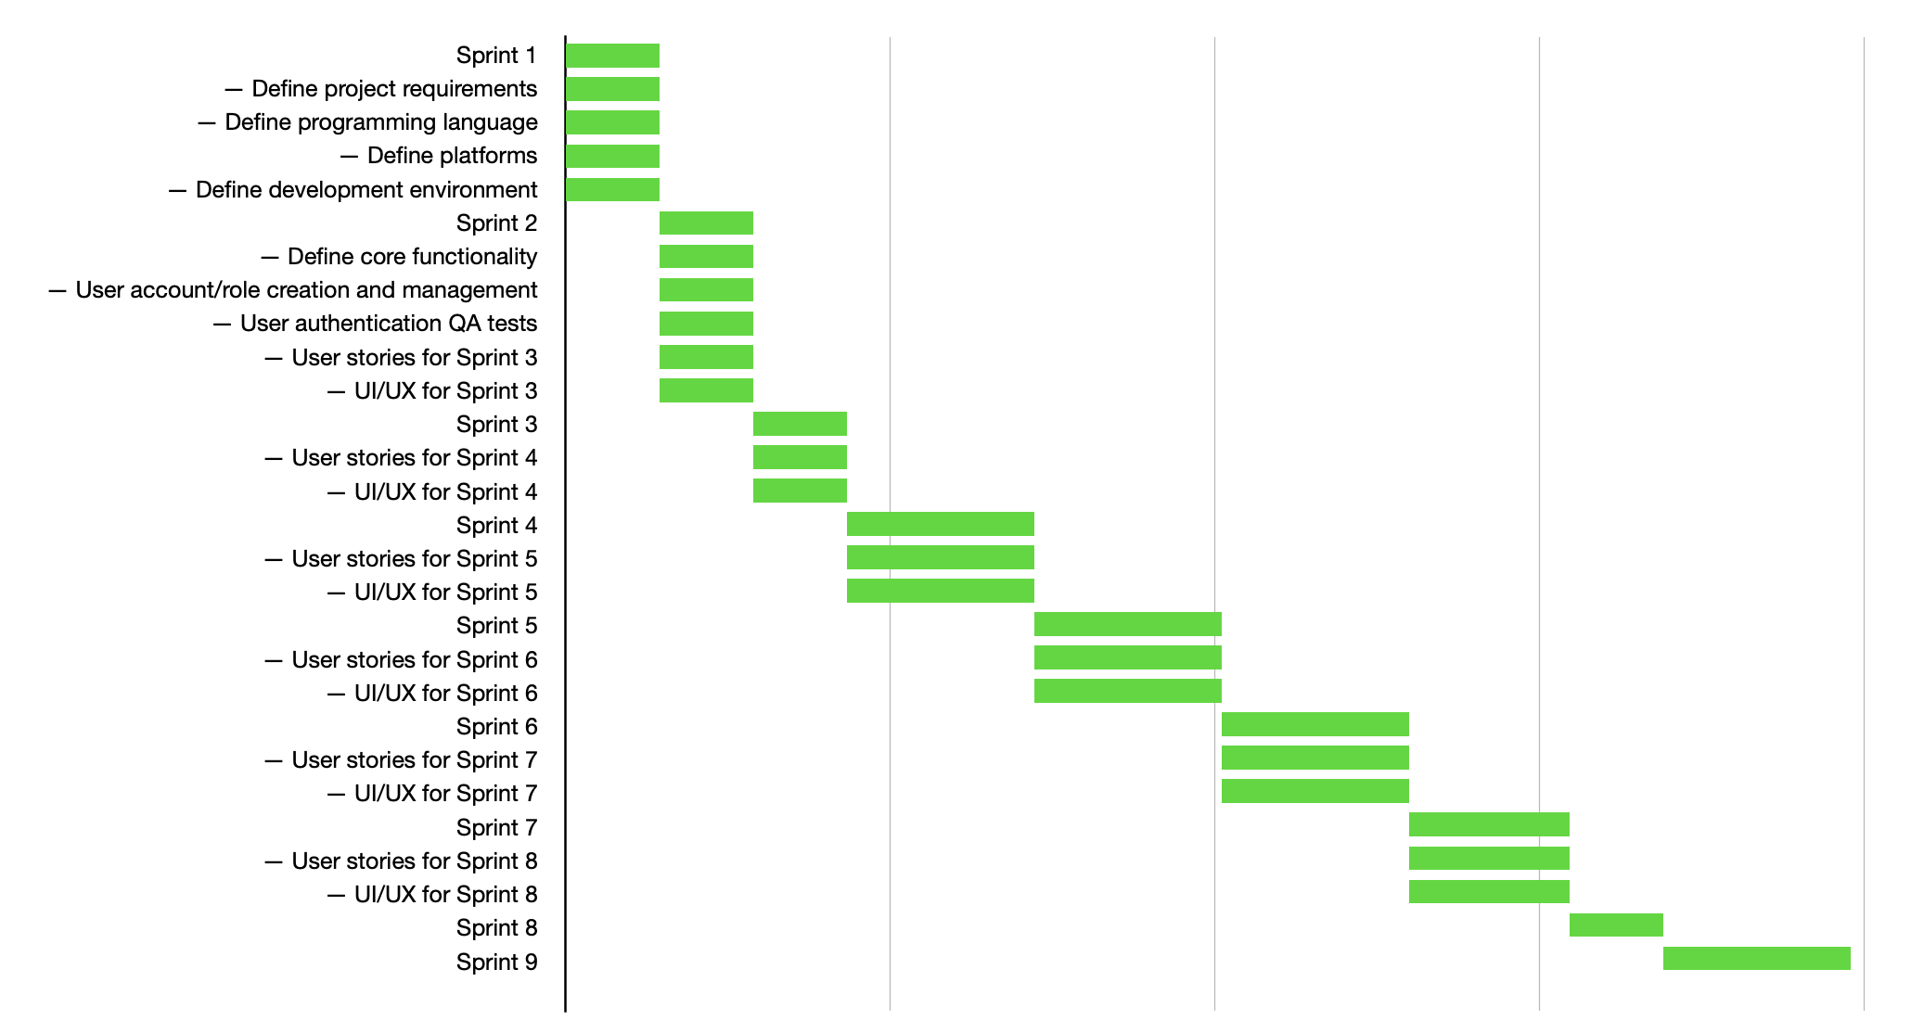
Project Plan
Notes:
collin

Slide 12
Estimated Effort
Sprint 1
Travis: 16-24
Quentin: 16-24
Dustin: 16-24
Jakob: 16-24
Luis: 16-24
Collin: 16-24
Sprint 2
Travis: 16-24
Quentin: 16-24
Dustin: 16-24
Jakob: 16-24
Luis: 16-24
Collin: 16-24
Sprint 3
Travis: 16-24
Quentin: 16-24
Dustin: 16-24
Jakob: 16-24
Luis: 16-24
Collin: 16-24
Notes:
Luis

Slide 13
Risk Analysis
Pace of play and wait times may be inaccurate if geofencing isn’t implemented
Not all players will use the app, causing skewed pace of play and estimated wait times (stale data)
Limited experience developing for mobile may cause late deliverables
Inaccuracies in calculation/formulation of wait times for holes may cause a medium margin of error
Notes:
Luis

